Slide 1


Slide 2
Web Robot Doctor
Presented by:
Ammar Shafiq
20-CS-34
Ali Burhan
20-CS-34

Slide 3
Introduction
Web doctor is an online medical support for anyone. Everyone from around the world can access this and check for any disease symptoms. The user simply give detail about the symptoms according to the given symptoms the project informs the user about the disease that might have the same symptoms. This project will give medicines about the disease just by analyzing the symptoms. This will be the really easy for any curious patient because patient can simply find medicine by accessing this website and make report for patient ease if required than also suggest the tests for patient. This project will also inform patient about the closest related doctor in case the user wants to contact any doctor

Slide 4
Languages / Frame work
HTML
CSS
JavaScript
Bootstrap
SQL
PHP

Slide 5
Tools
Visual Studio Code
XAMPP
Photoshop 2018
Adobe Illustrator 2020

Slide 6
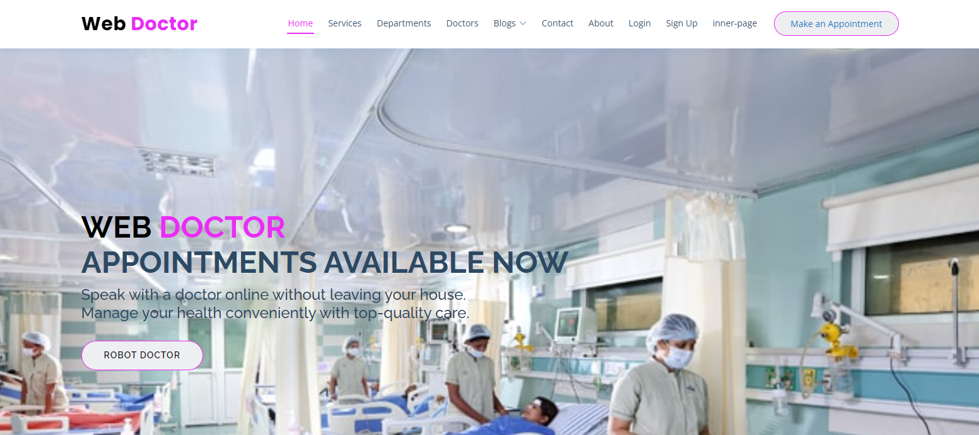

Slide 7
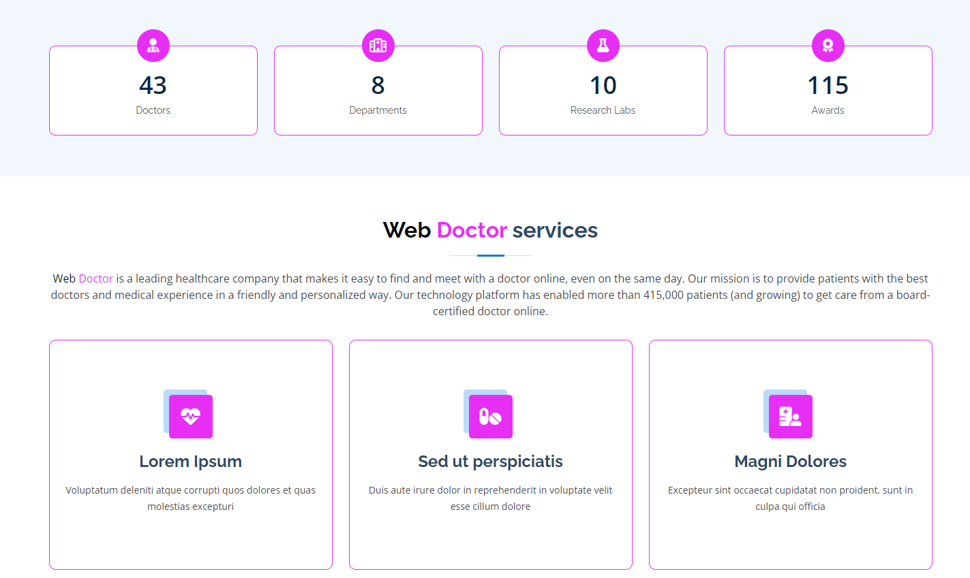

Slide 8
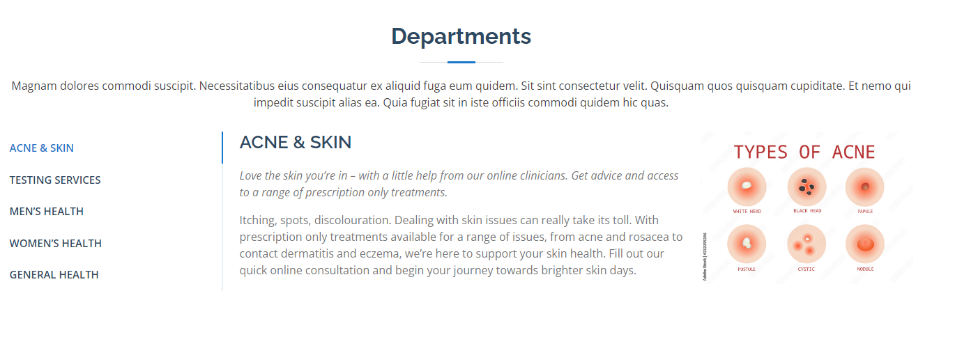

Slide 9
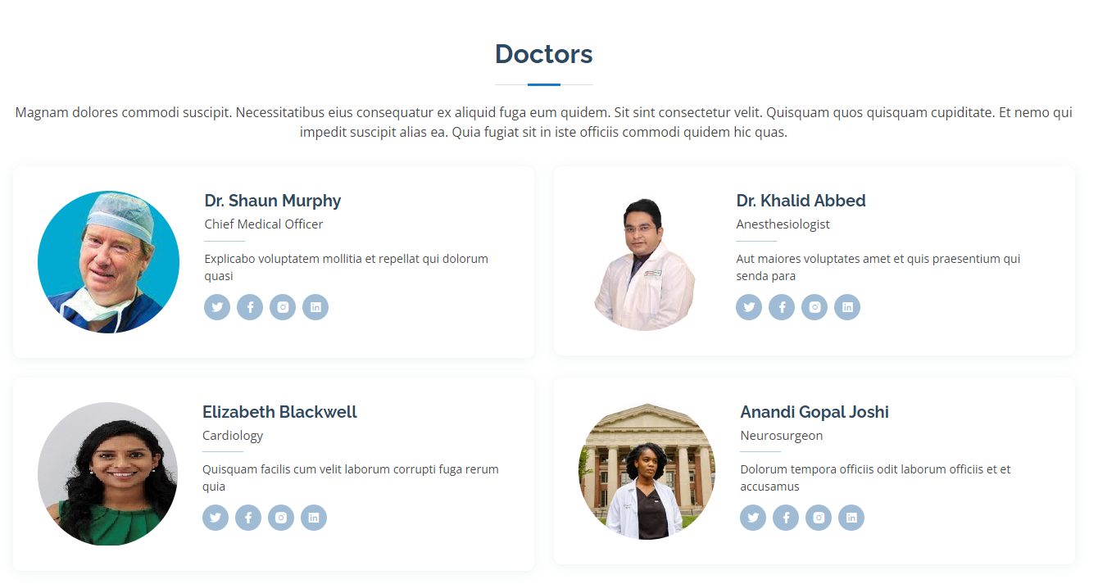

Slide 10
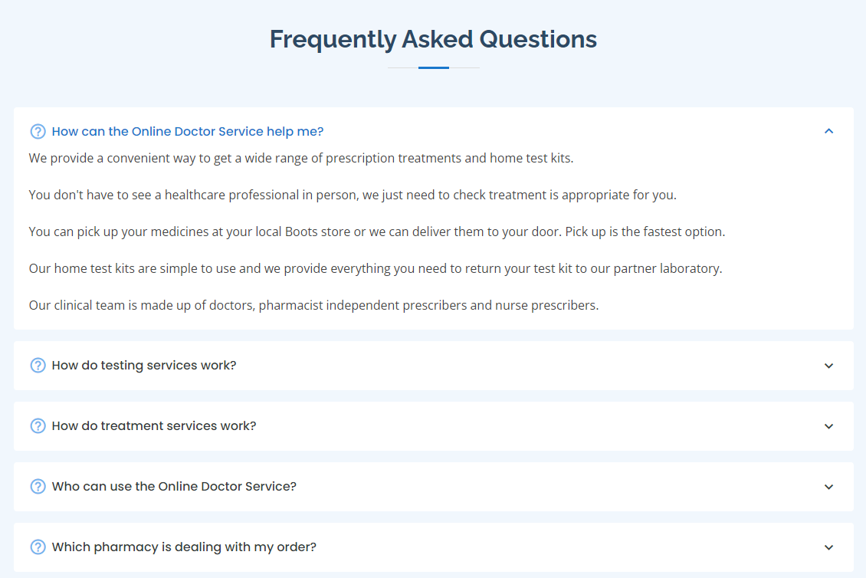

Slide 11
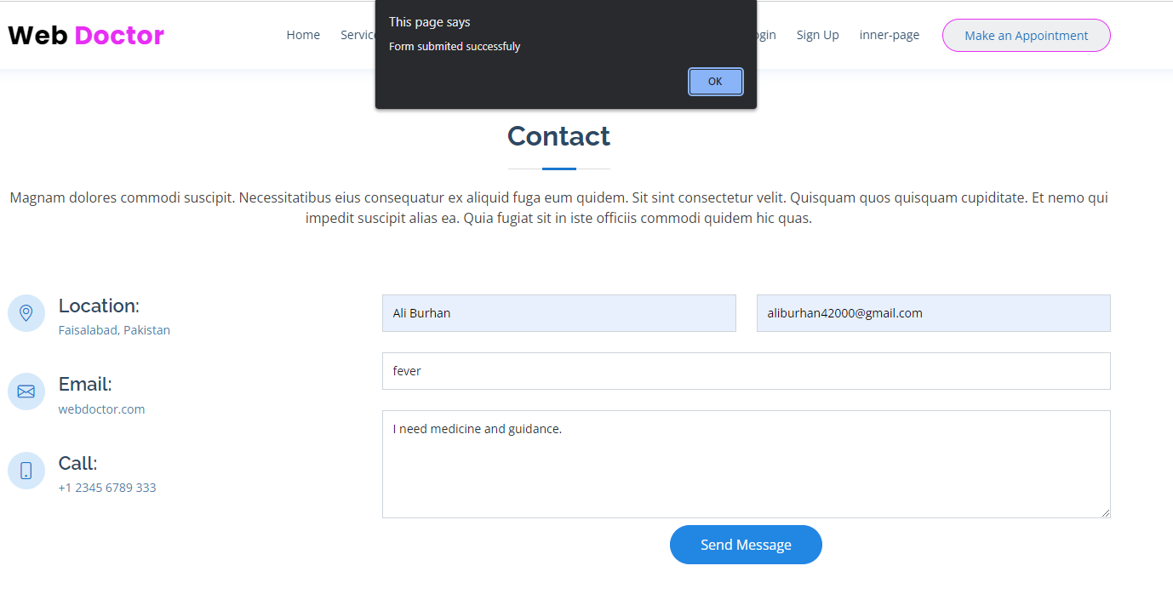

Slide 12
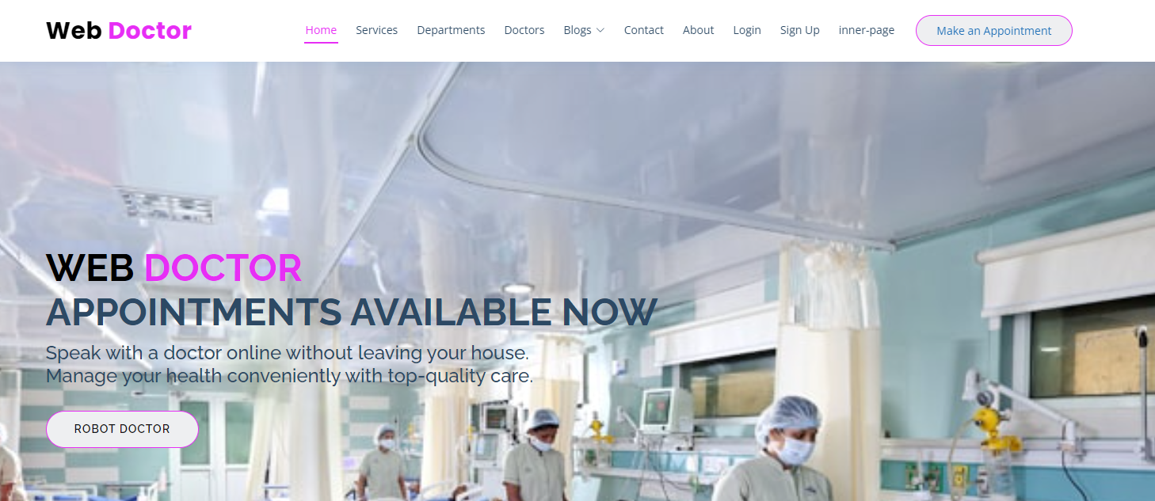
Web Robot Doctor

Slide 13
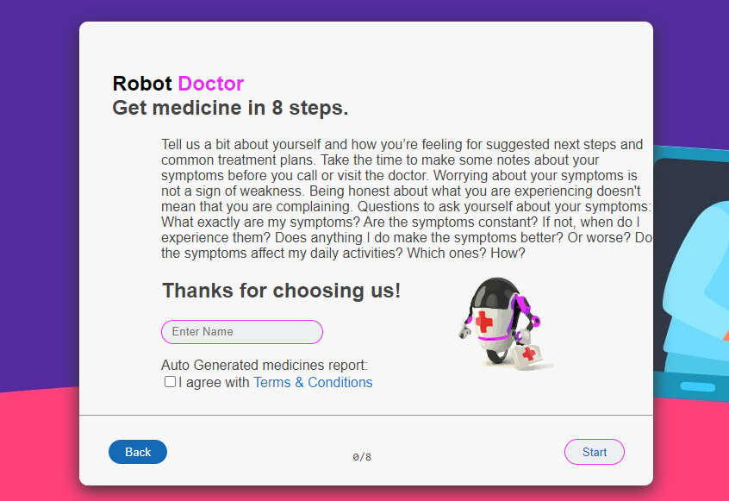
Introduction

Slide 14
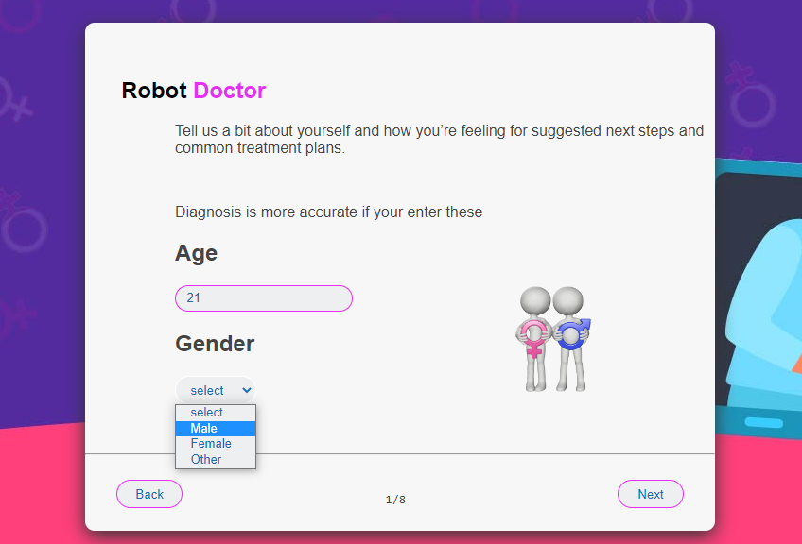
Info

Slide 15
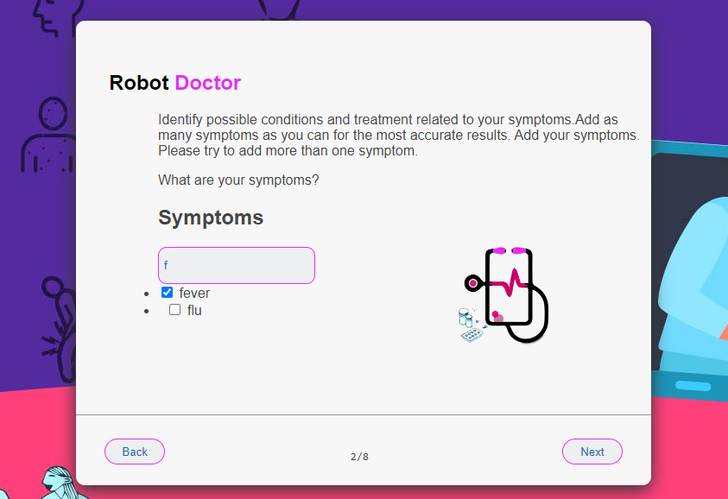
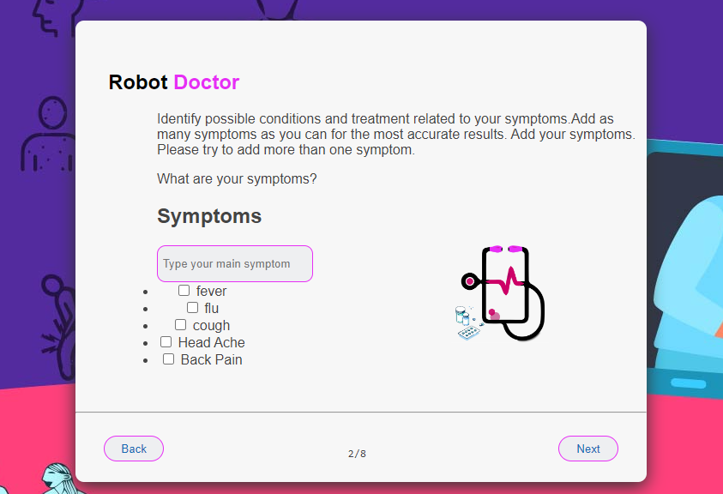
Symptoms

Slide 16
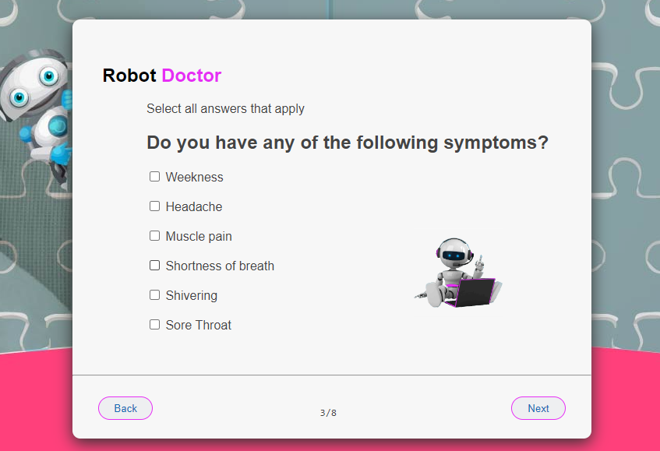
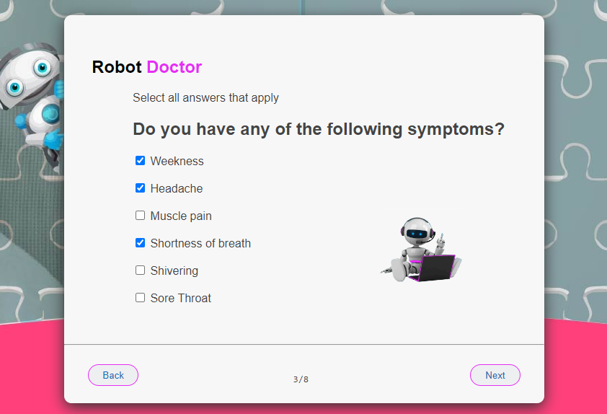
Symptoms

Slide 17
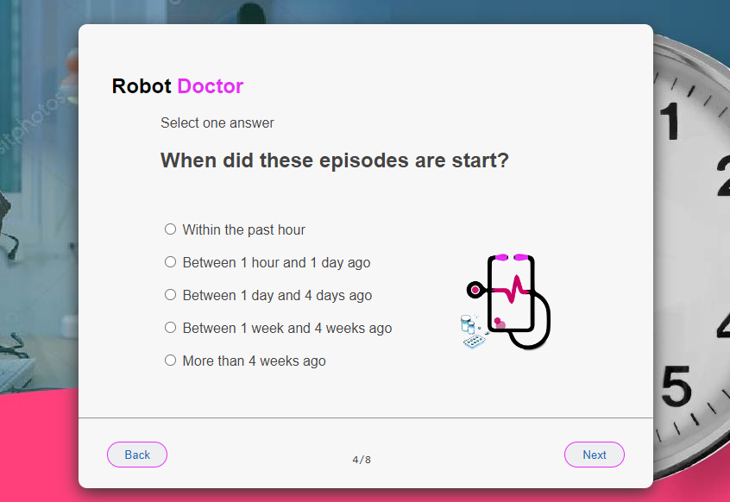
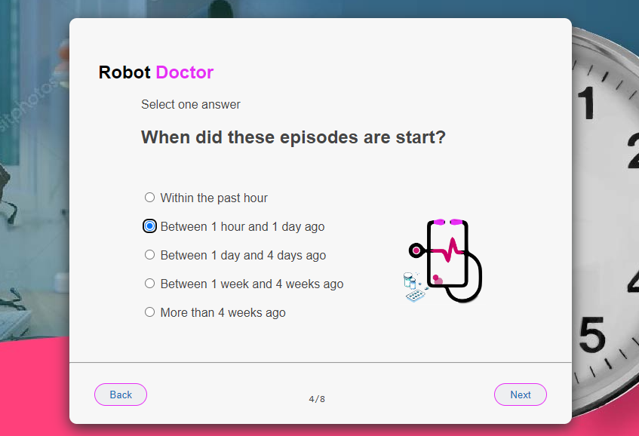
Duration

Slide 18
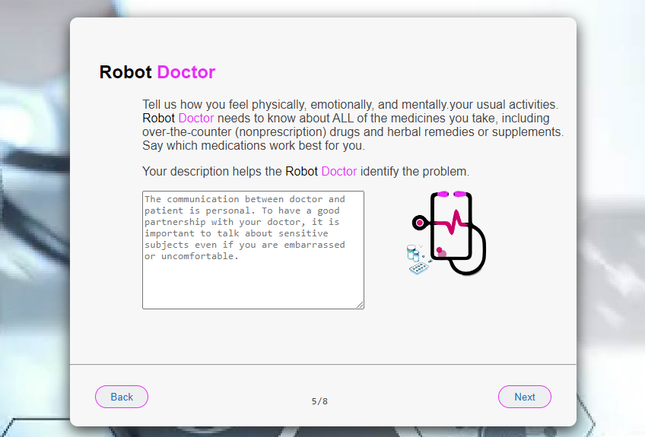
Description

Slide 19
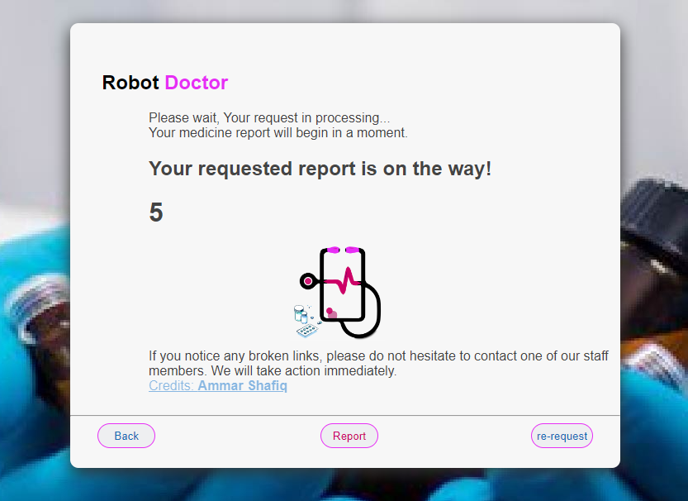
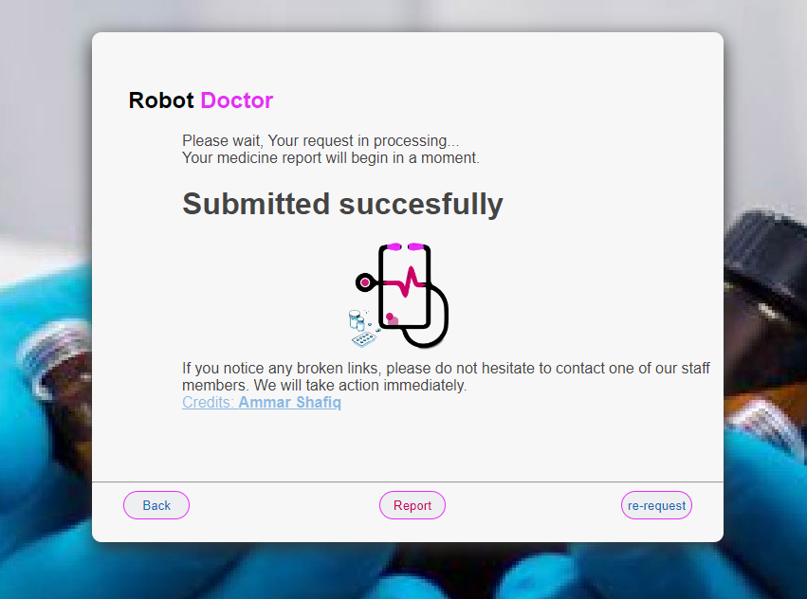
Requesting to server

Slide 20
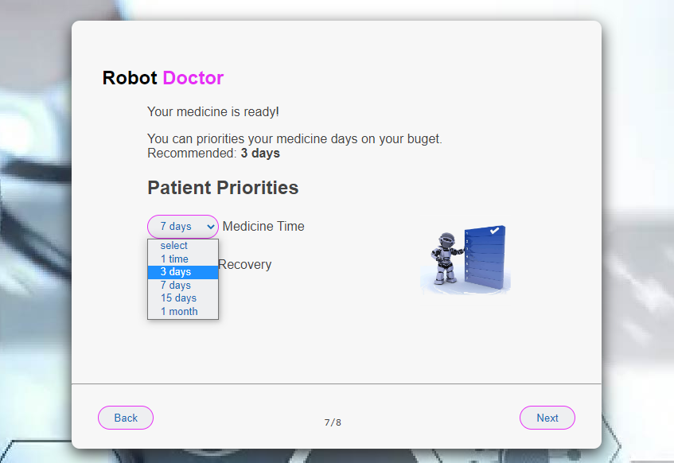
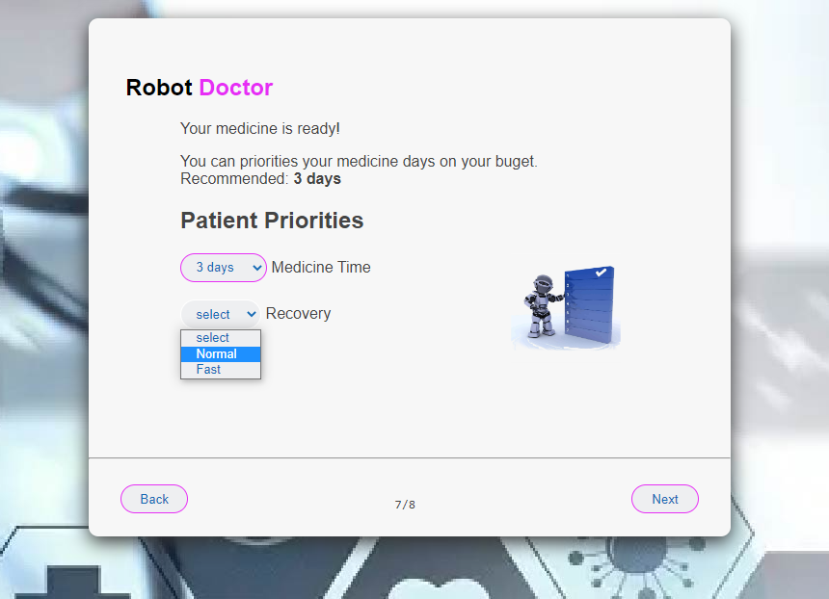
Options

Slide 21
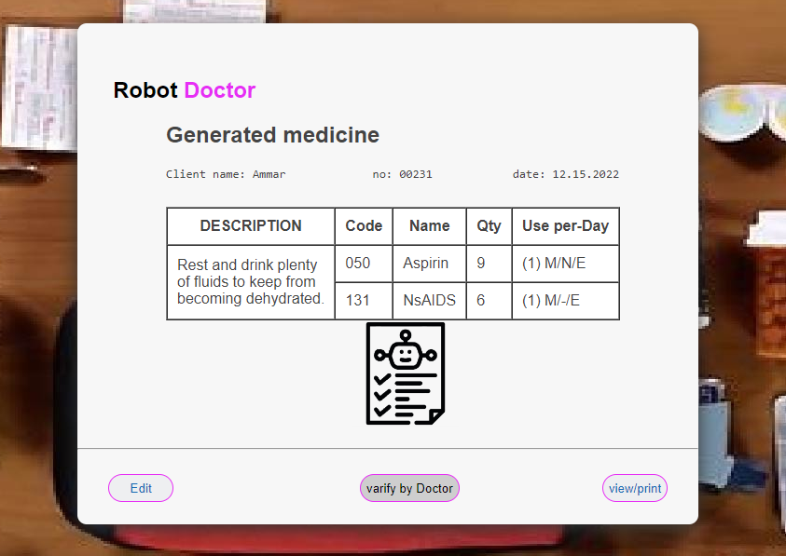
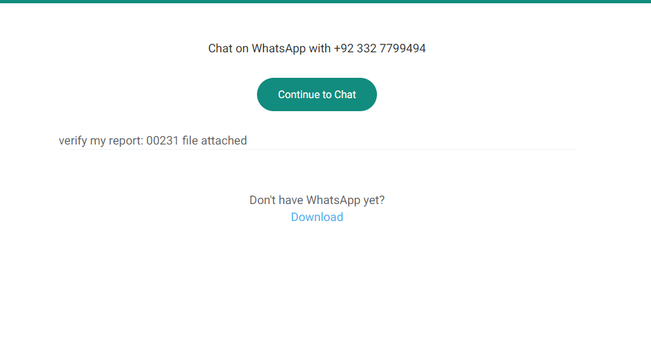
Medicine is ready

Slide 22
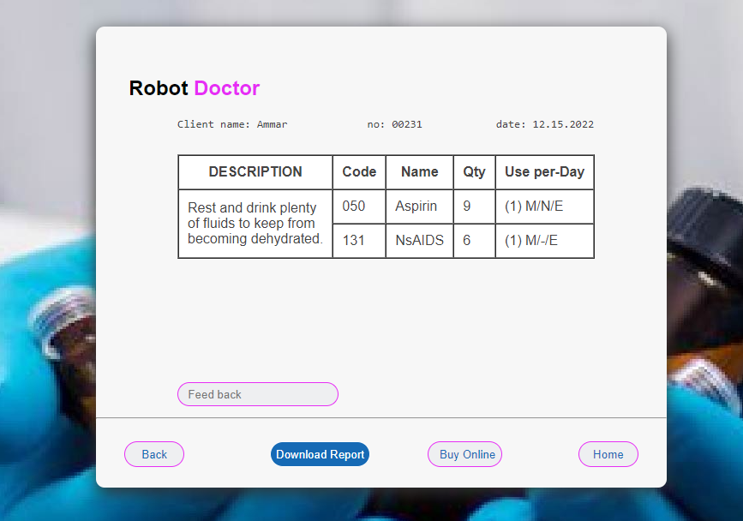
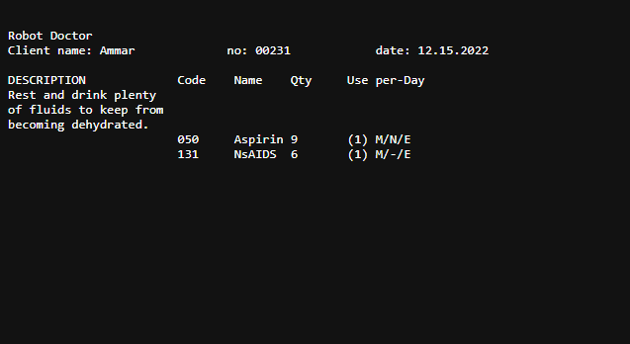
Report

Slide 23
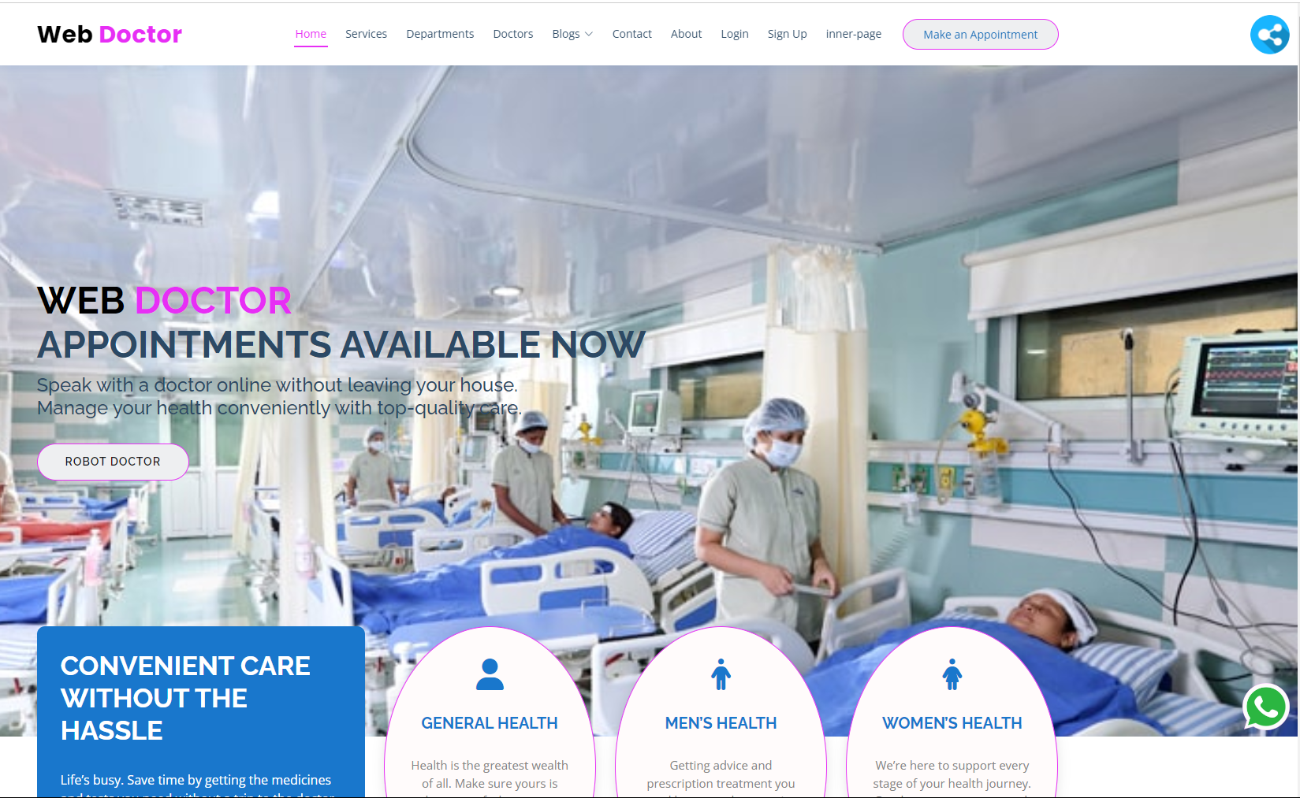

Slide 24
Thank You

Slide 25
Any Question?

Slide 26
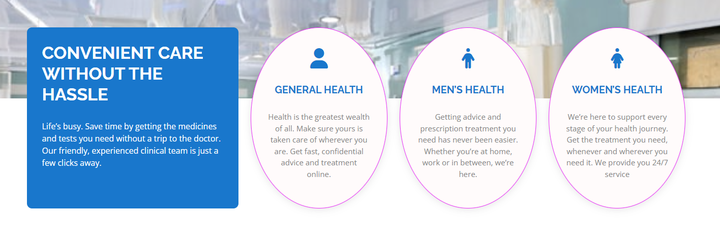
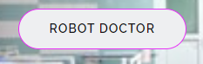
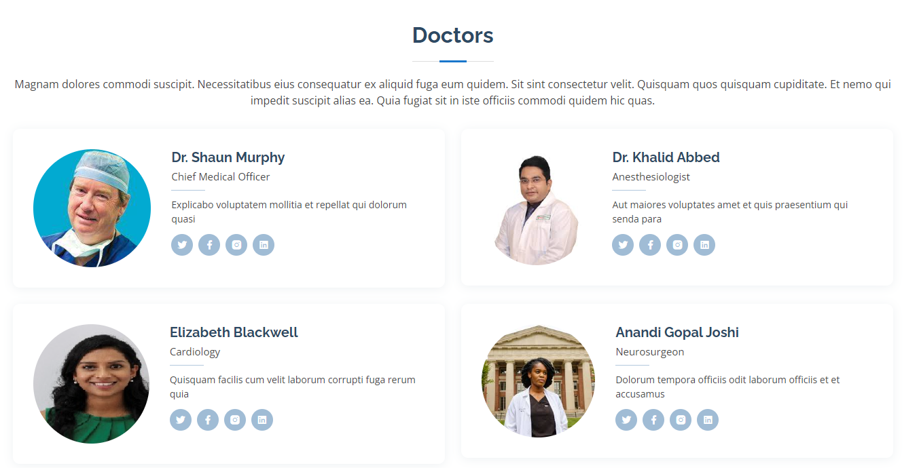

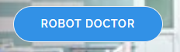









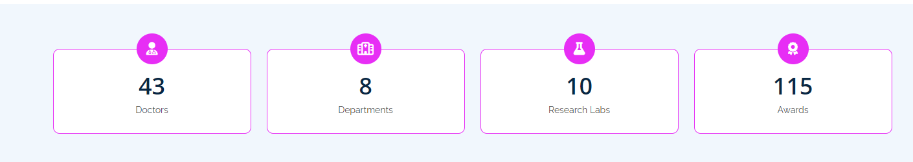

Web Robot Doctor

